Slide 1
Computer Organization

Slide 2
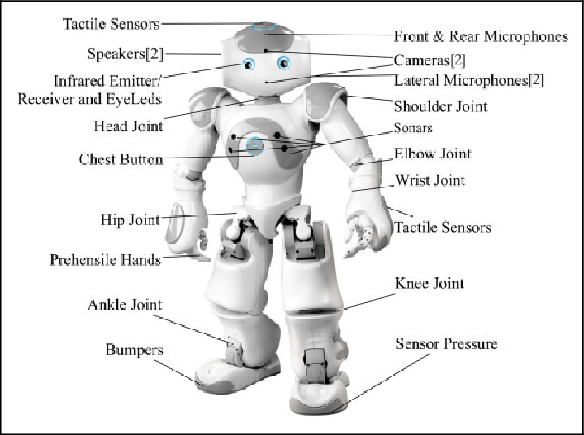
COMPUTER SYSTEM

Slide 3

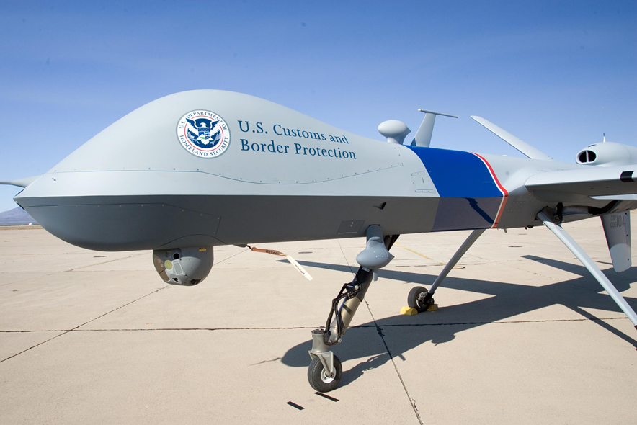
COMPUTER SYSTEM unmanned aerial vehicle (UAV)

Slide 4
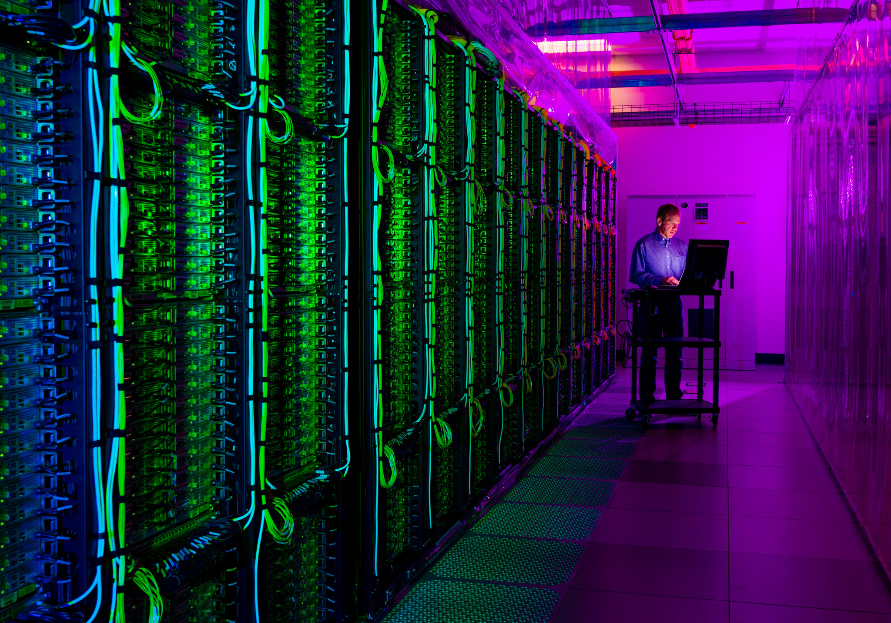

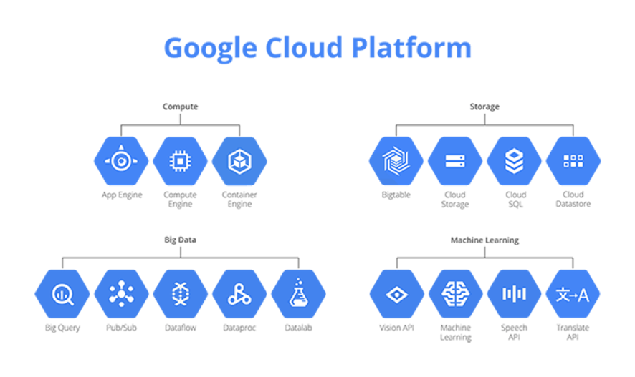
Computer System GOOGLE CLOUD

Slide 5
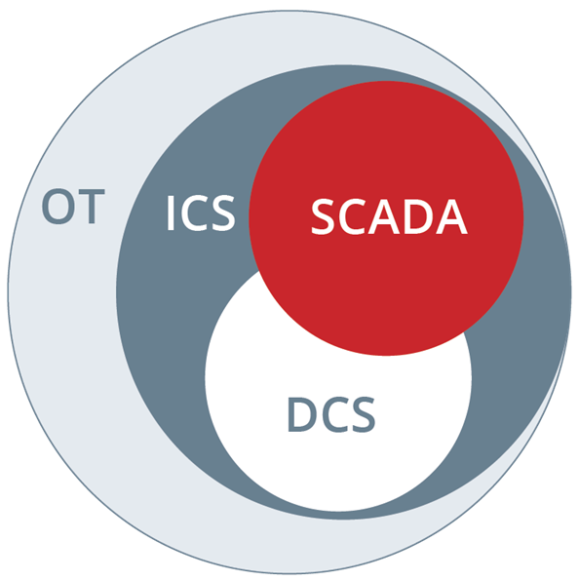
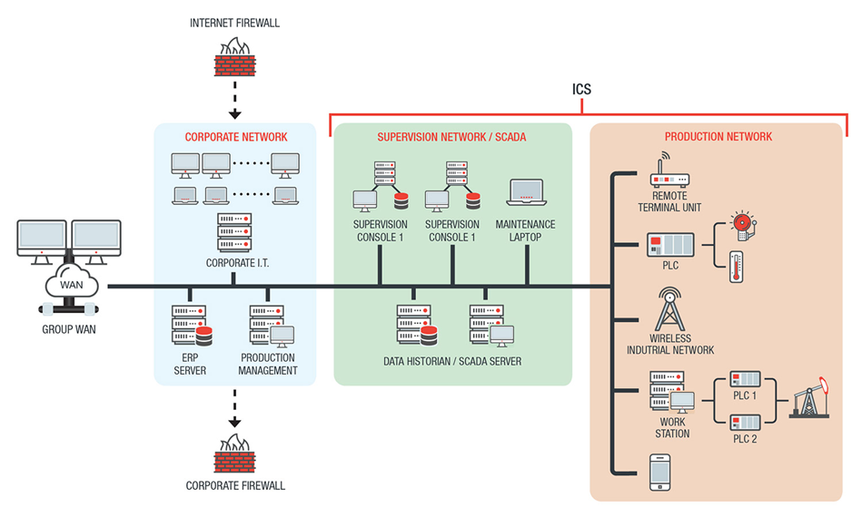
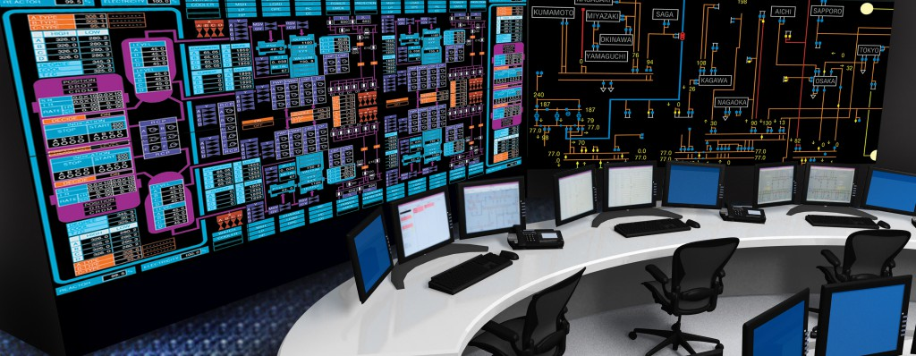
Computer System Industrial Control System (ICS)

Slide 6
Computer hardware

Slide 7
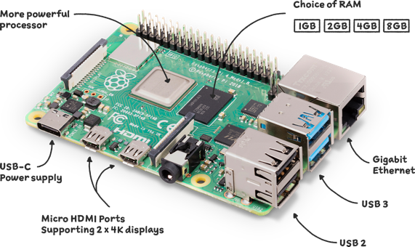
Computer hardware raspberry pi 4

Slide 8
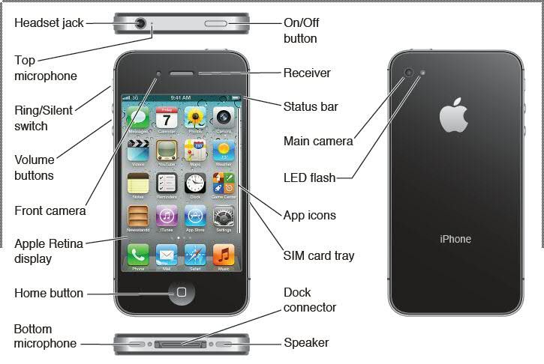
Computer hardware iphone

Slide 9
Von Neumann architecture
The von Neumann architecture — also known as the von Neumann model or Princeton architecture — is a computer architecture based on a 1945 description by John von Neumann, and by others, in the First Draft of a Report on the EDVAC. The document describes a design architecture for an electronic digital computer with these components:
A processing unit with both an arithmetic logic unit and processor registers
A control unit that includes an instruction register and a program counter
Memory that stores data and instructions
External mass storage
Input and output mechanisms

Slide 10
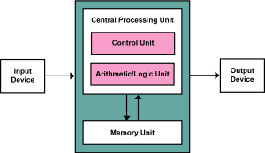
CENTRAL PROCESSING UNIT

Slide 11

John von Neumann
John von Neumann was a Hungarian-American mathematician, physicist, computer scientist, engineer, and polymath. His Hungarian name was Neumann János Lajos, and he died on February 8, 1957. He was hailed as "the last representative of the great mathematicians who were equally at home in both pure and applied mathematics" and was thought to have had the broadest scope of any mathematician of his era. He combined the pure and applied sciences.

Slide 12
Instruction set architecture
An abstract representation of a computer is known as an instruction set architecture (ISA), often known as computer architecture. An implementation is a machine that carries out the instructions specified by that ISA, such as a central processing unit (CPU).
In general, an ISA defines the supported instructions, data types, registers, the hardware support for managing main memory, fundamental features (such as the memory consistency, addressing modes, virtual memory), and the input/output model of a family of implementations of the ISA.
An ISA specifies the behavior of machine code running on implementations of that ISA in a fashion that does not depend on the characteristics of that implementation, providing binary compatibility between implementations. This enables multiple implementations of an ISA that differ in characteristics such as performance, physical size, and monetary cost (among other things), but that are capable of running the same machine code, so that a lower-performance, lower-cost machine can be replaced with a higher-cost, higher-performance machine without having to replace software. It also enables the evolution of the microarchitectures of the implementations of that ISA, so that a newer, higher-performance implementation of an ISA can run software that runs on previous generations of implementations.

Slide 13
MEMORY HEIRACHY
In computer architecture, the memory hierarchy separates computer storage into a hierarchy based on response time. Since response time, complexity, and capacity are related, the levels may also be distinguished by their performance and controlling technologies. Memory hierarchy affects performance in computer architectural design, algorithm predictions, and lower level programming constructs involving locality of reference.
Designing for high performance requires considering the restrictions of the memory hierarchy, i.e. the size and capabilities of each component. Each of the various components can be viewed as part of a hierarchy of memories (m₁, m₂, ..., m _{n}) in which each member m_{i} is typically smaller and faster than the next highest member m_{i+1} of the hierarchy. To limit waiting by higher levels, a lower level will respond by filling a buffer and then signaling for activating the transfer.
There are four major storage levels.^{[1]}
Internal – Processor registers and cache.
Main – the system RAM and controller cards.
On-line mass storage – Secondary storage.
Off-line bulk storage – Tertiary and Off-line storage.

Slide 14
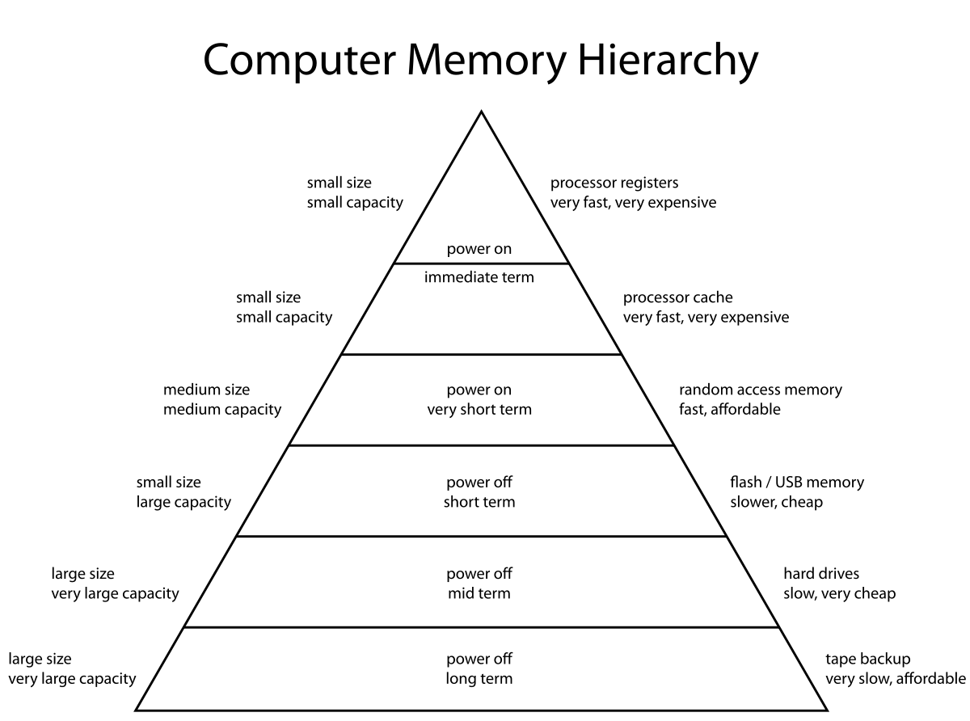
COMPUTER MEMORY HIERARCHY

Slide 15
Principle of locality
According to the localization principle of physics, an object is only directly impacted by its immediate surroundings. A "local theory" is one that takes the concept of locality into account. The idea of immediate "activity at a distance" is replaced by this. The field theories of classical physics gave rise to locality. The idea is that anything in the area between the two sites must operate as a mediator if an activity at one point is to have an impact at another. The influence must be carried by anything that moves through the space between the two sites, such a wave or particle.
The speed at which all such influences can move is restricted to the speed of light, displaystyle c, by the special theory of relativity. As a result, the principle of locality indicates that an occurrence at one location cannot have the same effect at another location at the same time. Displaystyle T=D/c, where Displaystyle D is the distance between the points and Displaystyle c is the speed of light in a vacuum, states that an event at Displaystyle A cannot result at Displaystyle B in a time less than Displaystyle T=D/c.

Slide 16
RAM vs ROM
RAM is volatile memory, which means that the information temporarily stored in the module is erased when you restart or shut down your computer. Because the information is stored electrically on transistors, when there is no electric current, the data disappears. Each time you request a file or information, it is retrieved either from the computer's storage disk or the internet. The data is stored in RAM, so each time you switch from one program or page to another, the information is instantly available. When the computer is shut down, the memory is cleared until the process begins again. Volatile memory can be changed, upgraded, or expanded easily by users.
ROM stands for non-volatile memory in computers., which means the information is permanently stored on the chip. The memory does not depend on an electric current to save data, instead, data is written to individual cells using binary code. Non-volatile memory is used for parts of the computer that do not change, such as the initial boot-up portion of the software, or the firmware instructions that make your printer run. Turning off the computer does not have any effect on ROM. Non-volatile memory cannot be changed by users.

Slide 17
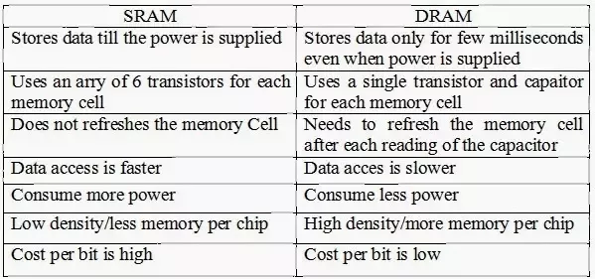
DRAM vs SRAM
Static Random Access Memory (SRAM) Dynamic Random Access Memory (DRAM

Slide 18
Computer software: operating system

Slide 19
Computer software: Operating system
An operating system (OS) is a type of system software that controls how computer hardware and software resources are used and offers basic services to other software applications. Operating systems that use time-sharing plan activities to make the most of the system's resources. They may also contain accounting software to allocate costs for processing time, mass storage, printing, and other resources. Although application code is typically performed directly by hardware and frequently makes system calls to an OS function or is interrupted by it, the operating system acts as a bridge between programs and the computer hardware for hardware functions like input and output and memory allocation. From mobile phones and video game consoles to web servers and supercomputers, many devices that house a computer have operating systems.

Slide 20
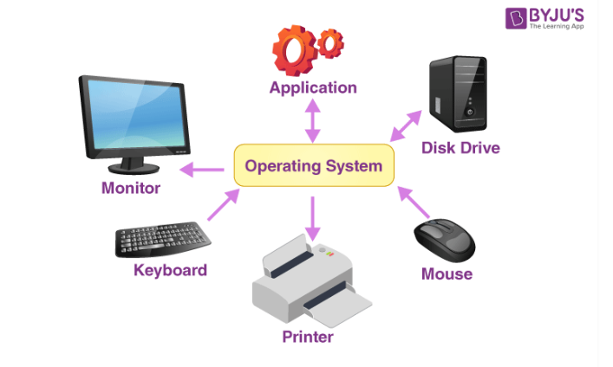
Operating system

Slide 21
Kind of os:
Types of Operating System
There are several different types of operating systems present. In this section, we will discuss the advantages and disadvantages of these types of OS.
Batch OS
Distributed OS
Multitasking OS
Network OS
Real-OS
Mobile OS

Slide 22
Batch OS
Batch OS is the first operating system for second-generation computers. This OS does not directly interact with the computer. Instead, an operator takes up similar jobs and groups them together into a batch, and then these batches are executed one by one based on the first-come, first, serve principle.

Slide 23
Batch OS
Advantages of Batch OS
Execution time taken for similar jobs is higher.
Multiple users can share batch systems.
Managing large works becomes easy in batch systems.
The idle time for a single batch is very less.
Disadvantages of OS
It is hard to debug batch systems.
If a job fails, then the other jobs have to wait for an unknown time till the issue is resolved.
Batch systems are sometimes costly.
Examples of Batch OS: payroll system, bank statements, data entry, etc.

Slide 24
Distributed OS
A distributed operating system is a new development in computer technology that is being used quickly and widely everywhere. Multiple computers are linked together by a single communication channel in a distributed operating system. These separate computers are referred to as loosely connected systems since they each have their own memory and CPU. The system processes can execute a variety of tasks and come in various sizes. The main advantage of this kind of operating system is that it allows users to view files that are located on connected systems rather than on their own systems. Additionally, the systems linked to this network have remote access available.

Slide 25
Distributed OS
Advantages of Distributed OS
Failure of one system will not affect the other systems because all the computers are independent of each other.
The load on the host system is reduced.
The size of the network is easily scalable as many computers can be added to the network.
As the workload and resources are shared therefore the calculations are performed at a higher speed.
Data exchange speed is increased with the help of electronic mail.
Disadvantages of Distributed OS
The setup cost is high.
Software used for such systems is highly complex.
Failure of the main network will lead to the failure of the whole system.
Examples of Distributed OS: LOCUS, etc.

Slide 26
Multitasking OS
The multitasking OS is also known as the time-sharing operating system as each task is given some time so that all the tasks work efficiently. This system provides access to a large number of users, and each user gets the time of CPU as they get in a single system. The tasks performed are given by a single user or by different users. The time allotted to execute one task is called a quantum, and as soon as the time to execute one task is completed, the system switches over to another task.

Slide 27
Multitasking OS
Advantages of Multitasking OS
Each task gets equal time for execution.
The idle time for the CPU will be the lowest.
There are very few chances for the duplication of the software.
Disadvantages of Multitasking OS
Processes with higher priority cannot be executed first as equal priority is given to each process or task.
Various user data is needed to be taken care of from unauthorized access.
Sometimes there is a data communication problem.
Examples of Multitasking OS: UNIX, etc.

Slide 28
Network OS
Network operating systems are the systems that run on a server and manage all the networking functions. They allow sharing of various files, applications, printers, security, and other networking functions over a small network of computers like LAN or any other private network. In the network OS, all the users are aware of the configurations of every other user within the network, which is why network operating systems are also known as tightly coupled systems.

Slide 29
Network OS
Advantages of Network OS
New technologies and hardware can easily upgrade the systems.
Security of the system is managed over servers.
Servers can be accessed remotely from different locations and systems.
The centralized servers are stable.
Disadvantages of Network OS
Server costs are high.
Regular updates and maintenance are required.
Users are dependent on the central location for the maximum number of operations.
Examples of Network OS: Microsoft Windows server 2008, LINUX, etc.

Slide 30
Real-OS
Real-Time operating systems serve real-time systems. These operating systems are useful when many events occur in a short time or within certain deadlines, such as real-time simulations.
Types of the real-time OS are:
Hard real-time OS
The hard real-time OS is the operating system for mainly the applications in which the slightest delay is also unacceptable. The time constraints of such applications are very strict. Such systems are built for life-saving equipment like parachutes and airbags, which immediately need to be in action if an accident happens.
Soft real-time OS
The soft real-time OS is the operating system for applications where time constraint is not very strict.
In a soft real-time system, an important task is prioritized over less important tasks, and this priority remains active until the completion of the task. Furthermore, a time limit is always set for a specific job, enabling short time delays for future tasks, which is acceptable. For Example, virtual reality, reservation systems, etc.

Slide 31
Real-Time OS
Advantages of Real-Time OS
It provides more output from all the resources as there is maximum utilization of systems.
It provides the best management of memory allocation.
These systems are always error-free.
These operating systems focus more on running applications than those in the queue.
Shifting from one task to another takes very little time.
Disadvantages of Real-Time OS
System resources are extremely expensive and are not so good.
The algorithms used are very complex.
Only limited tasks can run at a single time.
In such systems, we cannot set thread priority as these systems cannot switch tasks easily.
Examples of Real-Time OS: Medical imaging systems, robots, etc.

Slide 32
Mobile OS
A mobile OS is an operating system for smartphones, tablets, and PDA’s. It is a platform on which other applications can run on mobile devices.
Advantages of Mobile OS
It provides ease to users.
Disadvantages of Mobile OS
Some of mobile operating systems give poor battery quality to users.
Some of the mobile operating systems are not user-friendly.
Examples of Mobile OS: Android OS, ios, Symbian OS, and Windows mobile OS.

Slide 33
C
Security The operating system uses password protection to protect user data and similar other techniques. it also prevents unauthorized access to programs and user data.
Control over system performance Monitors overall system health to help improve performance. records the response time between service requests and system response to having a complete view of the system health. This can help improve performance by providing important information needed to troubleshoot problems.
Job accounting
Operating system Keeps track of time and resources used by various tasks and users, this information can be used to track resource usage for a particular user or group of users

Slide 34
functions of an operating System:
Error detecting aids – The operating system constantly monitors the system to detect errors and avoid the malfunctioning of a computer system.
Coordination between other software and users – Operating systems also coordinate and assign interpreters, compilers, assemblers, and other software to the various users of the computer systems.

Slide 35
Real-time OS: RTOS
A real-time operating system (RTOS) is an operating system (OS) for real-time applications that processes data and events that have critically defined time constraints. An RTOS is distinct from a time-sharing operating system, such as Unix, which manages the sharing of system resources with a scheduler, data buffers, or fixed task prioritization in a multitasking or multiprogramming environment. Processing time requirements need to be fully understood and bound rather than just kept as a minimum. All processing must occur within the defined constraints. Real-time operating systems are event-driven and preemptive, meaning the OS is capable of monitoring the relevant priority of competing tasks, and make changes to the task priority. Event-driven systems switch between tasks based on their priorities, while time-sharing systems switch the task based on clock interrupts.

Slide 36
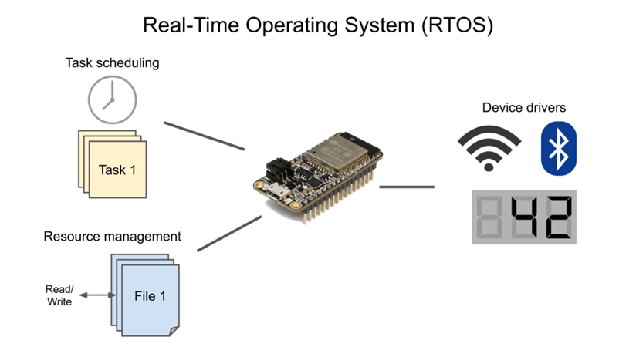
Real-time OS: RTOS

Slide 37
Windows operating system
Windows is an operating system designed by Microsoft. The operating system is what allows you to use a computer. Windows comes preloaded on most new personal computers (PCs), which helps to make it the most popular operating system in the world.
Windows makes it possible to complete all types of everyday tasks on your computer. For example, you can use Windows to browse the Internet, check your email, edit digital photos, listen to music, play games, and do much more.

Slide 38
TYPES OF WINDOWS
WINDOWS 3.X
Windows 3.0, released in 1990, improved the design, mostly because of virtual memory and loadable virtual device drivers (VxDs) that allow Windows to share arbitrary devices between multi-tasked DOS applications.Windows 3.0 applications can run in protected mode, which gives them access to several megabytes of memory without the obligation to participate in the software virtual memory scheme. They run inside the same address space, where the segmented memory provides a degree of protection. Windows 3.0 also featured improvements to the user interface. Microsoft rewrote critical operations from C into assembly. Windows 3.0 was the first version of Windows to achieve broad commercial success, selling 2 million copies in the first six months.

Slide 39
Windows 9x
The next major consumer-oriented release of Windows, Windows 95, was released on August 24, 1995. While still remaining MS-DOS-based, Windows 95 introduced support for native 32-bit applications, plug and play hardware, preemptive multitasking, long file names of up to 255 characters, and provided increased stability over its predecessors. Windows 95 also introduced a redesigned, object oriented user interface, replacing the previous Program Manager with the Start menu, taskbar, and Windows Explorer shell. Windows 95 was a major commercial success for Microsoft; Ina Fried of CNET remarked that "by the time Windows 95 was finally ushered off the market in 2001, it had become a fixture on computer desktops around the world."^{[24]} Microsoft published four OEM Service Releases (OSR) of Windows 95, each of which was roughly equivalent to a service pack. The first OSR of Windows 95 was also the first version of Windows to be bundled with Microsoft's web browser, Internet Explorer.

Slide 40
Windows NT
Main article: Windows NT
Version history
Early versions (Windows NT 3.1/3.5/3.51/4.0/2000)
In November 1988, a new development team within Microsoft (which included former Digital Equipment Corporation developers Dave Cutler and Mark Lucovsky) began work on a revamped version of IBM and Microsoft's OS/2 operating system known as "NT OS/2". NT OS/2 was intended to be a secure, multi-user operating system with POSIX compatibility and a modular, portable kernel with preemptive multitasking and support for multiple processor architectures.

Slide 41
Windows XP
Main article: Windows XP
The next major version of Windows NT, Windows XP, was released on October 25, 2001. The introduction of Windows XP aimed to unify the consumer-oriented Windows 9x series with the architecture introduced by Windows NT, a change which Microsoft promised would provide better performance over its DOS-based predecessors. Windows XP would also introduce a redesigned user interface (including an updated Start menu and a "task-oriented" Windows Explorer), streamlined multimedia and networking features, Internet Explorer 6, integration with Microsoft's .NET Passport services, a "compatibility mode" to help provide backwards compatibility with software designed for previous versions of Windows, and Remote Assistance functionality.[

Slide 42
Windows Vista
Main article: Windows Vista
After a lengthy development process, Windows Vista was released on November 30, 2006, for volume licensing and January 30, 2007, for consumers. It contained a number of new features, from a redesigned shell and user interface to significant technical changes, with a particular focus on security features. It was available in a number of different editions, and has been subject to some criticism, such as drop of performance, longer boot time, criticism of new UAC, and stricter license agreement. Vista's server counterpart, Windows Server 2008 was released in early 2008.

Slide 43
Windows 7
Main article: Windows 7
On July 22, 2009, Windows 7 and Windows Server 2008 R2 were released as RTM (release to manufacturing) while the former was released to the public 3 months later on October 22, 2009. Unlike its predecessor, Windows Vista, which introduced a large number of new features, Windows 7 was intended to be a more focused, incremental upgrade to the Windows line, with the goal of being compatible with applications and hardware with which Windows Vista was already compatible. Windows 7 has multi-touch support, a redesigned Windows shell with an updated taskbar with revealable jump lists that contain shortcuts to files frequently used with specific applications and shortcuts to tasks within the applicationa home networking system called HomeGroup,and performance improvements.

Slide 44
Windows 8 and 8.1
Main articles: Windows 8 and Windows 8.1
Windows 8, the successor to Windows 7, was released generally on October 26, 2012. A number of significant changes were made on Windows 8, including the introduction of a user interface based around Microsoft's Metro design language with optimizations for touch-based devices such as tablets and all-in-one PCs. These changes include the Start screen, which uses large tiles that are more convenient for touch interactions and allow for the display of continually updated information, and a new class of apps which are designed primarily for use on touch-based devices. The new Windows version required a minimum resolution of 1024×768 pixels,effectively making it unfit for netbooks with 800×600-pixel screens.

Slide 45
Windows 10
Main article: Windows 10
On September 30, 2014, Microsoft announced Windows 10 as the successor to Windows 8.1. It was released on July 29, 2015, and addresses shortcomings in the user interface first introduced with Windows 8. Changes on PC include the return of the Start Menu, a virtual desktop system, and the ability to run Windows Store apps within windows on the desktop rather than in full-screen mode. Windows 10 is said to be available to update from qualified Windows 7 with SP1, Windows 8.1 and Windows Phone 8.1 devices from the Get Windows 10 Application (for Windows 7, Windows 8.1) or Windows Update (Windows 7).[

Slide 46
Windows 11
Main article: Windows 11
On June 24, 2021, Windows 11 was announced as the successor to Windows 10 during a livestream. The new operating system was designed to be more user-friendly and understandable. It was released on October 5, 2021.^{[54][55]} As of May 2022, Windows 11 is a free upgrade to Windows 10 users who meet the system requirements.

Slide 47
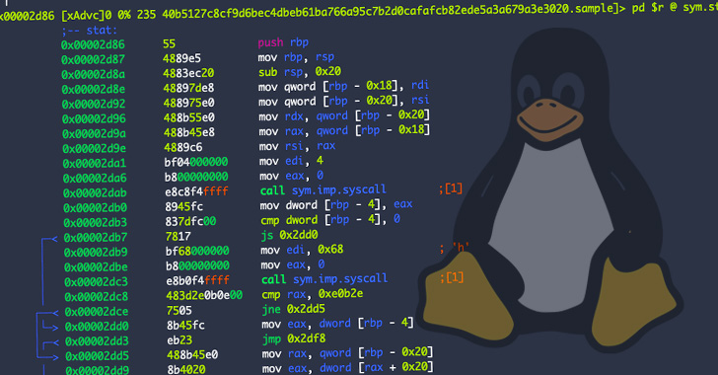
LINUX
Linux is an open source operating system (OS). An operating system is the software that directly manages a system's hardware and resources, like CPU, memory, and storage. The OS sits between applications and hardware and makes the connections between all of your software and the physical resources that do the work.

Slide 48
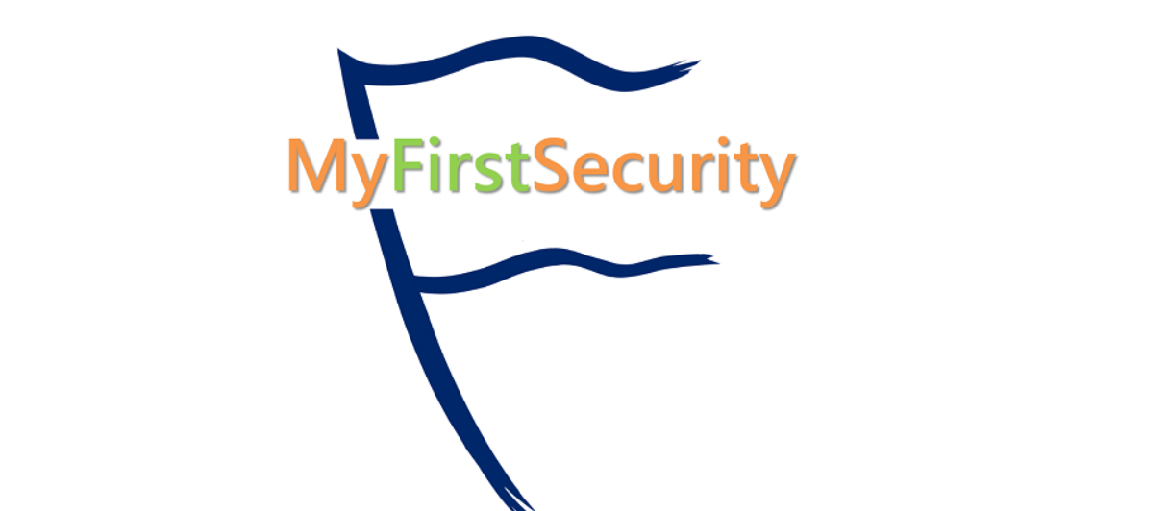

Slide 49
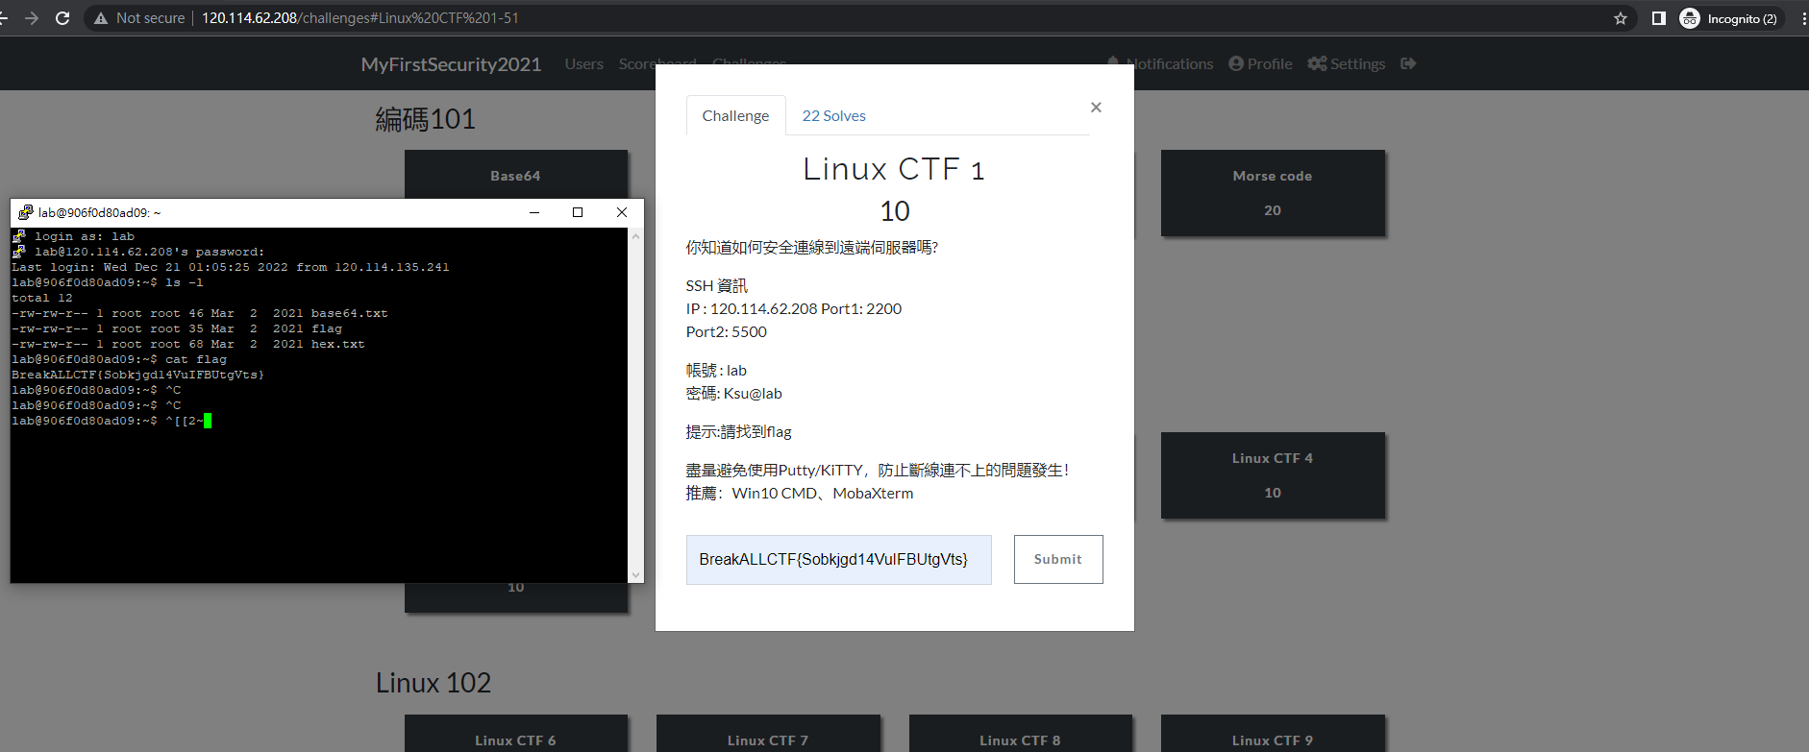
LINUX CTF 1

Slide 50
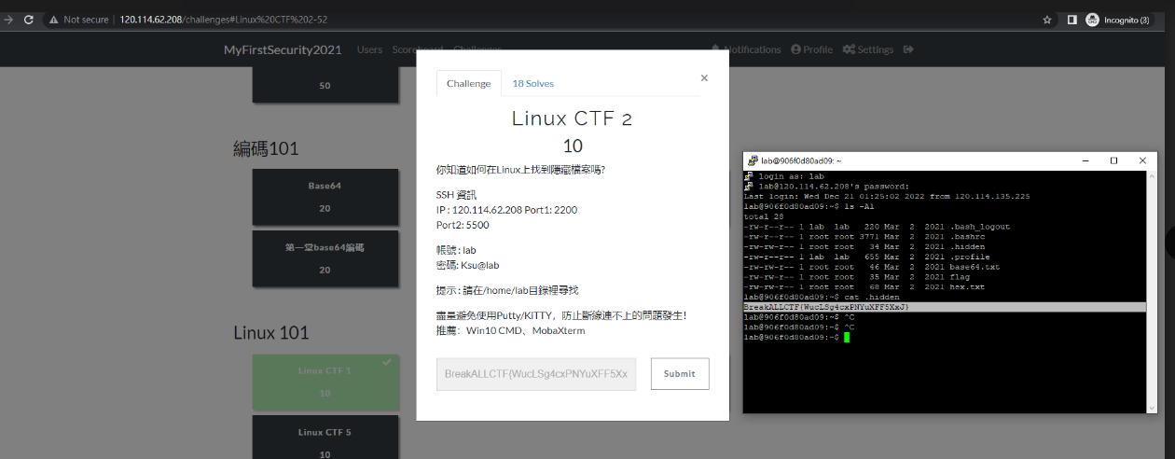
LINUX CTF 2

Slide 51
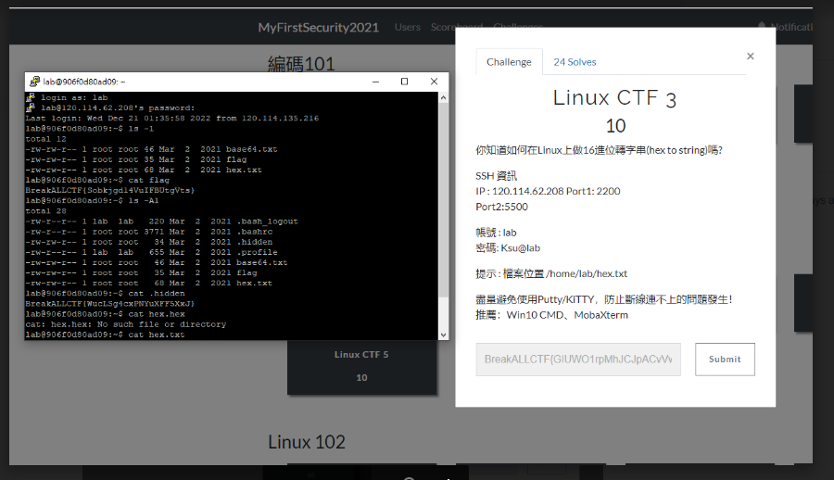
LINUX CTF3

Slide 52
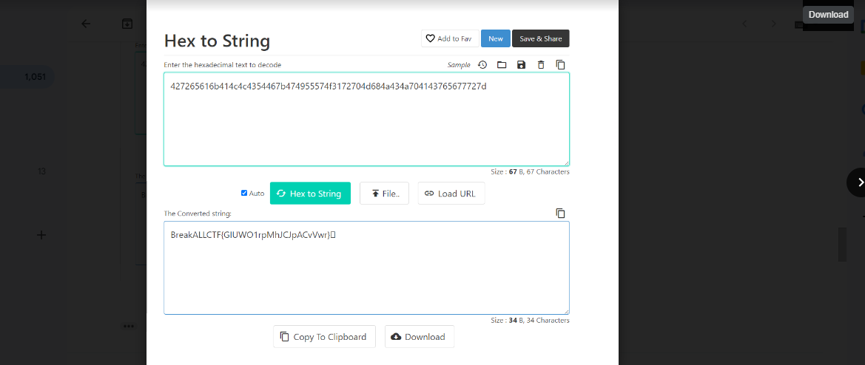

Slide 53
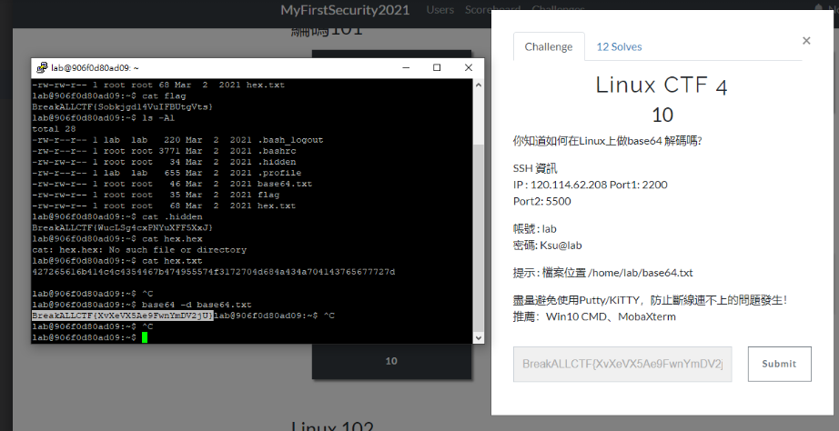
LINUX CTF 4

